Slide 1

WEEK 01
INFORMATION SYSTEM AND IT GOVERNANCE
ICT407: IT Governance

Slide 2

ICT407 IT Governance
This is a foundational subject that addresses the core concepts, frameworks, and methods for IT Leaders such as IT Managers and Chief Information Officers, to support their organisations in creating and delivering business value with information and technology through business-IT alignment. Student will gain knowledge about benefit realisation, risk optimisation, and resource management for any business., The subject takes an enterprise wide, managerial perspective on how IT executives can facilitate the transition towards digital business and set and agenda for IT in larger organisations. Students will learn to analyse an organisation’s business model, and evaluate IT governance policies through the lens of policy frameworks. Students will apply their IT governance knowledge to design commercial strategies rapidly changing businesses.
Core Unit
Master of IT
1 Semester
15 Credit Points
Face-to-face
10 hours (3 hours of lecturers, tutorials, labs and 7 hours of personal study)

Slide 3
Course Objectives
Explain and reframe key concepts, frameworks, and methods for governing IT in organisations.
Assess value, alignment, and governance in an organisational context for a digital innovation to support executive decision making.
Appraise conceptual frameworks for exploring system management issues in organisations.
Guide management processes associated with the organisational use of information systems and technology.
Develop a business case in the context of IT governance including benefits and risk to support executive decision making.
Create specialist documentation to communicate effectively to multidisciplinary, executive, specialist, and non-specialist audience.

Slide 4
List of Topics
Organisations, Values, Business Models.
IT Governance Frameworks.
Alignment between Business Strategy and ICT Policies.
ICT Strategies and Policies.
Legal and Ethical Context of IT Governance.
Policies in the Global Context; Outsourcing, Cloud.
Policies in Organisational Context; e-Government, Not-for-Profit Sector
COBIT and related frameworks and standards
Process Capability Model
Information Security

Slide 5
Open-Ended Question
How can IT governance frameworks support the strategic alignment between business goals and IT initiatives in modern organizations?
IT governance frameworks play a crucial role in aligning business goals with IT initiatives by providing structured guidelines and processes for decision-making, resource management, and performance measurement. They help organizations ensure that their IT investments are directly contributing to the achievement of business objectives. For instance, in cities like Sydney and Melbourne, businesses often leverage frameworks like COBIT or ITIL to optimize their IT operations, manage risks, and enhance value delivery. These frameworks facilitate clear communication between IT and business leaders, ensuring that IT strategies are developed in line with overall business strategies.

Slide 6
Assessment Tasks
Assessment Tasks | Week | Weight
1. Early intervention – Online Quiz test comprising of a variety of theoretical questions (MCQs and True/False). 500 words equivalent. | Week 3 | 10%
2. Mid-term test comprising of a variety of theory and calculation questions (Short Answer questions). 1,000 Words equivalent. | Week 6 | 30%
3.Individual Report on Evaluating Risk in a Business Opportunity Using COBIT. 1,000 words equivalent. | Week 9 | 20%
4. Business Proposal Report Task. 2,00 words equivalent. | Week 12 | 40%

Slide 7
Assessment Tasks
1. Early Intervention – Online Quiz:
Description: This is an online quiz test that includes multiple-choice questions (MCQs) and True/False questions. The total content covered is equivalent to 500 words.
Objective: The purpose of this assessment is to gauge the students' understanding of foundational concepts early in the course.
Weight: This task contributes 10% to the overall course grade.
Timing: This quiz is scheduled for Week 3.

Slide 8
Assessment Tasks
2. Mid-term Test:
Description: The mid-term test includes a variety of theory-based and calculation questions. Students are expected to answer short answer questions that amount to a total of 1,000 words.
Objective: This test aims to assess students' deeper understanding of the material covered in the first half of the course and their ability to apply theoretical knowledge to practical problems.
Weight: This assessment accounts for 30% of the overall grade.
Timing: The mid-term test is scheduled for Week 6.

Slide 9
Assessment Tasks
3. Individual Report on Evaluating Risk in a Business Opportunity Using COBIT:
Description: Students are required to write an individual report that evaluates risk in a business opportunity using the COBIT framework. The report should be 1,000 words in length.
Objective: This task allows students to apply the COBIT framework in a practical context, enhancing their understanding of risk management in IT governance.
Weight: This report makes up 20% of the overall course grade.
Timing: The report is due in Week 9.

Slide 10
Assessment Tasks
4. Business Proposal Report Task:
Description: This task involves writing a comprehensive business proposal report, equivalent to 2,000 words.
Objective: The business proposal report aims to develop students' ability to create detailed and well-structured business documents that align IT initiatives with business objectives.
Weight: This final assessment contributes 40% to the overall grade.
Timing: The proposal report is due in Week 12.

Slide 11

Topics & Learning Outcomes
Information System
01
Explain and reframe key concepts of Information System in the scope of IT Governance.
Enterprise Information System (EIS)
02
Assess value, alignment, and governance in an organisational context for a digital transformation innovation to support executive decision making.
IT Governance Framework
03
Explain and reframe key concepts of Information System and its relationship with IT Governance.

Slide 12
Information System
Goal: Explain and reframe key concepts of Information System in the scope of IT Governance.

Slide 13
Open-Ended Question
What are the primary objectives of IT governance in a modern enterprise?
The primary objectives of IT governance include ensuring that IT investments generate business value, managing IT risks effectively, and aligning IT strategies with business goals. For example, in Sydney, a financial institution might use IT governance to streamline its digital banking services, thereby enhancing customer satisfaction and operational efficiency.

Slide 14
Open-Ended Question
How can understanding IT governance benefit future IT leaders?
Understanding IT governance equips future IT leaders with the knowledge to align IT operations with business goals, manage resources efficiently, and mitigate risks. In Melbourne, for instance, IT leaders in a tech startup can use this knowledge to prioritize projects that offer the highest return on investment while ensuring compliance with regulatory standards.

Slide 15
Open-Ended Question
Why is it essential to cover various IT governance frameworks and methodologies in this course?
Covering various IT governance frameworks and methodologies provides students with a comprehensive understanding of different approaches and best practices. This knowledge is vital for selecting the most suitable framework for their organization. For example, a company in Brisbane may choose COBIT for its robust risk management capabilities, while another in Canberra might prefer ITIL for its service management focus.

Slide 16
Open-Ended Question
How have information systems evolved over the decades, and what impact has this evolution had on businesses?
Information systems have evolved from simple data processing tools to complex, integrated systems that support strategic decision-making. This evolution has enabled businesses to enhance productivity, improve customer service, and create new business models. For example, ERP systems implemented in large organizations in Melbourne have streamlined operations and provided real-time insights into business performance.

Slide 17
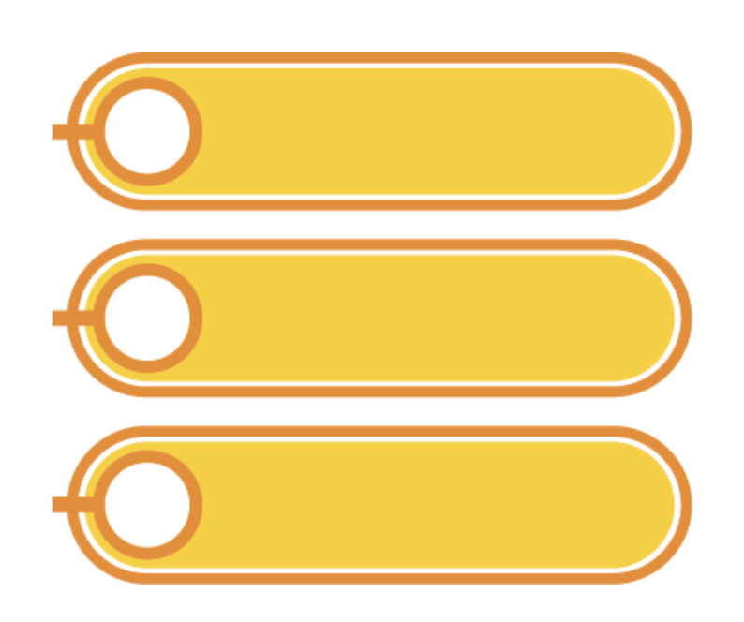
Information System: First Phase
Information System (IS) was strictly technical.
Automation means increase organisational productivity and efficiency, but each application is treated as a separate entity.
Database management was “Killer Application” with little attention to information management needs.
1980-1990s focuses on identifying relevant IT applications in data processing systems and management information system (MIS).
Phase 1
Phase 2
Phase 3
During the first phase of Information Systems (IS), the focus was strictly technical, with automation aimed at enhancing organizational productivity and efficiency. However, each application was treated as an isolated entity, and database management emerged as a critical application with minimal attention to broader information management needs.

Slide 18
Information System: Second Phase
A new concept was developed.
Management Service was renamed to Information System services.
The primary objective of which was to make information accessible to all departments of the organization.
Essential Issues: inter-connectivity, scalability, and reliability of the information system
Enterprise resource planning (ERP) software has an exponential increase in installations in large organizations.
Phase 1
Phase 2
Phase 3
In the second phase of Information Systems (IS), the focus shifted towards making information accessible across all departments by renaming Management Service to Information System services. This phase emphasized inter-connectivity, scalability, and reliability, with a significant rise in the implementation of Enterprise Resource Planning (ERP) software in large organizations.

Slide 19
Information System: Third Phase
The emergence of global networks and the WWW, which have overcome the traditional limitations of IT use.
Applications
An integral part of business strategies.
Develop alliances and collaborations beyond organisational and national boundaries.
The Internet
New digital relationships through interorganizational systems (e-commerce, e-business trends).
Emergence of new business models (product digitization, services sold, business processes delivery agents)
Phase 1
Phase 2
Phase 3
In the third phase of Information Systems (IS), the advent of global networks and the World Wide Web (WWW) overcame traditional IT limitations, making applications an integral part of business strategies. This phase also saw the development of alliances and collaborations beyond organizational and national boundaries, alongside the emergence of new business models driven by e-commerce and e-business trends.

Slide 20
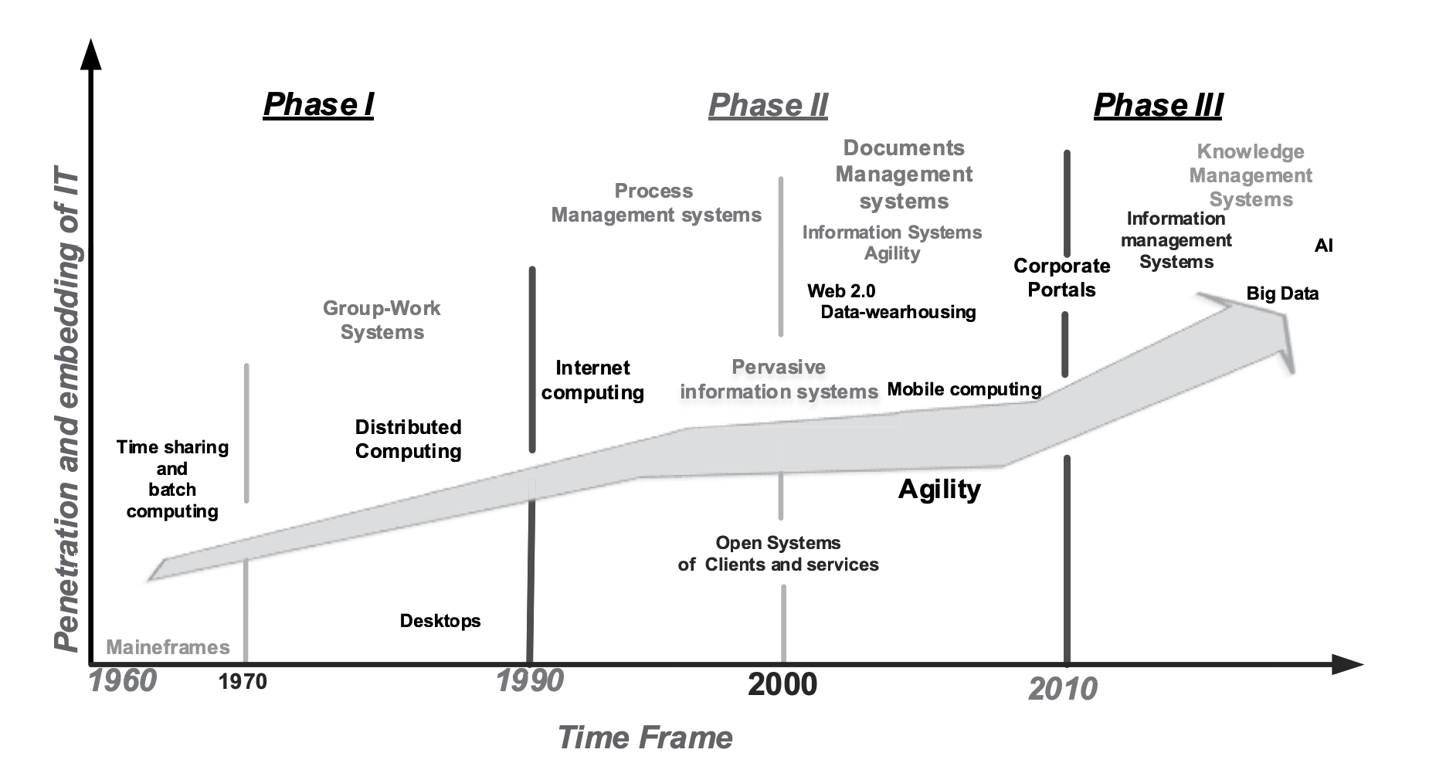
The diagram illustrates the evolution of Information Technology (IT) from the 1960s to the 2010s, showing increasing penetration and embedding of IT within organizations through three distinct phases. Phase I involved mainframes and time-sharing systems, Phase II introduced distributed and internet computing, and Phase III saw the rise of mobile computing, corporate portals, and advanced technologies like AI and big data.

Slide 21
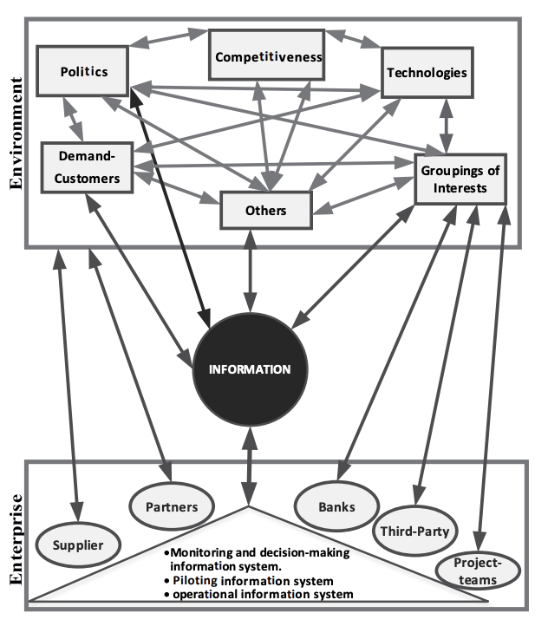
A Systemic View of the Company and the Environment
This diagram illustrates a systemic view of a company and its environment, highlighting the interconnectedness between various external factors such as politics, competitiveness, technologies, and customer demand, and internal enterprise components including suppliers, partners, banks, and project teams. Central to this system is the flow of information, which supports monitoring, decision-making, and operational processes within the organization.
Source: Galliers (2006)

Slide 22
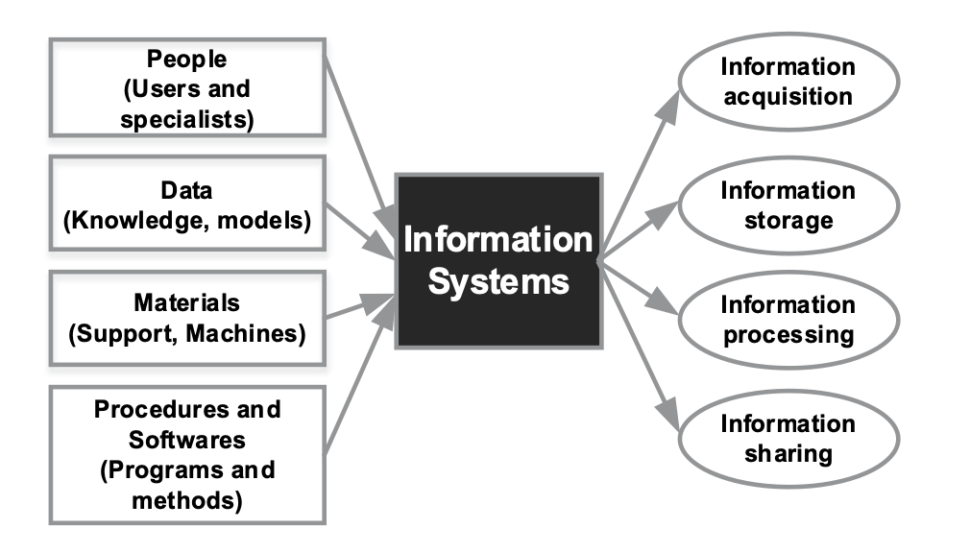
Information System Concept
The information system is the company’s nervous system.
The heart of its processes and strategy.
An effective way of connecting people, capitalise collective knowledge.
Enabler for decision makers to decide a suitable action at the right time.
The information system functions as the company's nervous system, central to its processes and strategy. It effectively connects people, capitalizes on collective knowledge, and enables decision-makers to take appropriate actions at the right time by facilitating information acquisition, storage, processing, and sharing.

Slide 23

Information System Resources
People: Users and Developers
Data: Knowledge and Models
Equipment: Computer Machines and Supports
Software and Procedures: Data Processing Program, allowing some functions such as: acquisition, processing, storage and communication of information in various forms in an organisation
Information System Resources include people (users and developers), data (knowledge and models), equipment (computer machines and supports), and software and procedures (data processing programs). These resources facilitate various functions such as the acquisition, processing, storage, and communication of information within an organization.

Slide 24
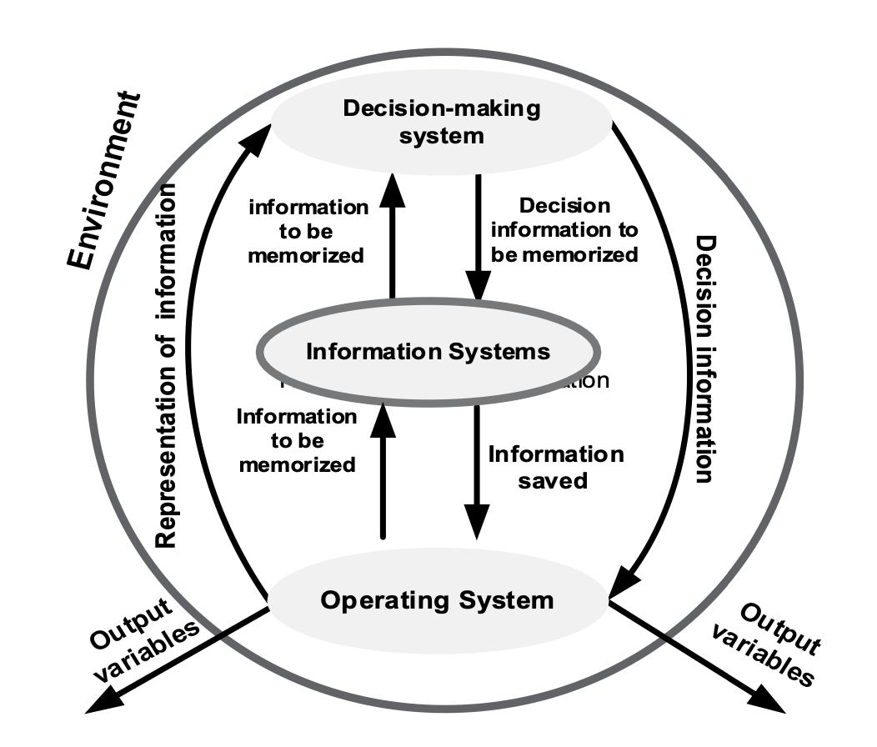
Systemic View of Information System
An organisation is defined as the composition of three systems:
Operating System
Decision Making or Piloting System
Information System
An organization is composed of three interrelated systems: the Operating System, the Decision Making or Piloting System, and the Information System. These systems work together to process, store, and utilize information for effective decision-making and operational efficiency within the organizational environment.

Slide 25
Enterprise Information System (EIS)
Goal: Explain and reframe key concepts of Information System and its relationship with IT Governance Evolution.

Slide 26
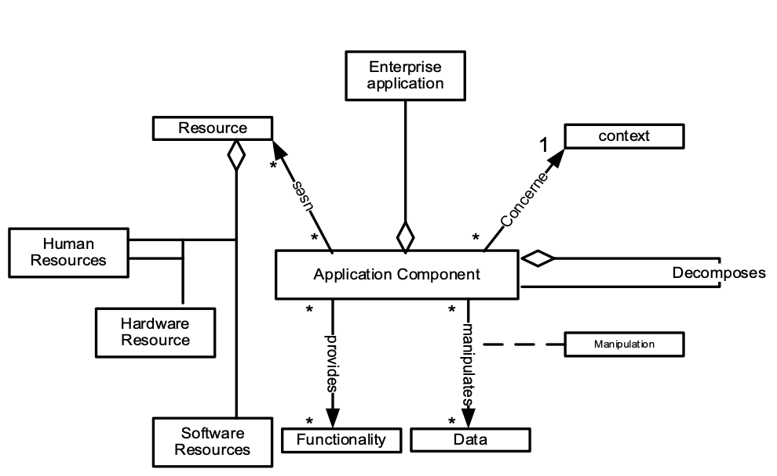
Enterprise Application (EIS)
EIS can contain a multitude of computer applications. It is a set of programs or software articulated between them, used to automate or assist information processing tasks in a particular area within the company. Source: Walls et al., 1992; Imache et al., 2012
Enterprise Information Systems (EIS) encompass a variety of computer applications that work together to automate and assist information processing tasks within specific areas of a company. These systems integrate human, hardware, and software resources to enhance functionality and data manipulation across the organization.

Slide 27
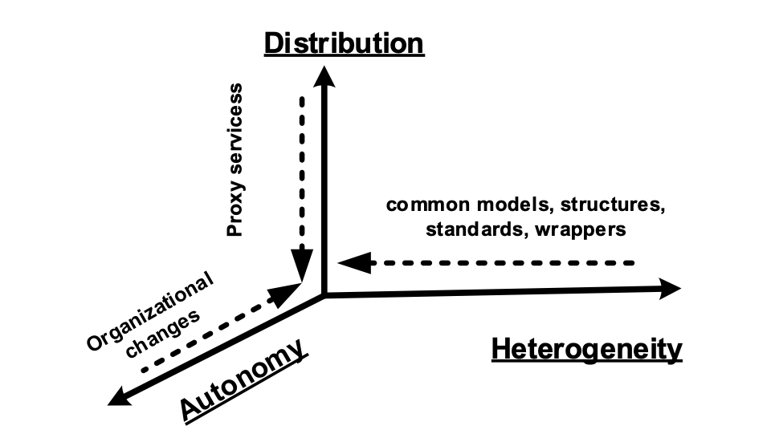
Features of Enterprise
Autonomy
Distribution
Heterogeneity
Source: Hasselbring, 2000; Roman et al., 2005
Enterprise applications are characterized by three main features: autonomy, distribution, and heterogeneity. Autonomy refers to the ability of applications to operate independently, distribution indicates that applications and data are spread across multiple locations, and heterogeneity signifies the use of diverse models, structures, and standards within the enterprise.

Slide 28
Autonomy
An organisational application is autonomous when it is possible to design and execute it independently.
Source: Textbook (pp.16)
An organizational application is considered autonomous when it can be designed and executed independently, without reliance on other systems or applications. This autonomy allows for greater flexibility and scalability within the enterprise.

Slide 29
Distribution
Organisational applications are physically distributed over enterprise network. This distributing the data and/or processing so that specific data and/or processing in the information system can be implemented at the local level. Source: Textbook (pp.17)
Organizational applications are physically distributed across the enterprise network, allowing data and processing tasks to be implemented locally. This distribution ensures that specific data and processes are handled efficiently at the local level, improving overall system performance and resilience.

Slide 30
Heterogeneity
The heterogeneity is an aspect inherent in that enterprise applications can be developed and deployed independently and according to different approaches and methodologies.
Source: Textbook (pp.17)
Heterogeneity in enterprise applications refers to their ability to be developed and deployed independently using different approaches and methodologies. This inherent diversity allows for flexibility and customization in addressing specific organizational needs and integrating various technologies.

Slide 31
Dynamism
Modern information systems must dynamically evolve to respond to strategic, commercial, or technological changes affecting the organization. This dynamism includes internal behavior adjustments and modifications within application components, ensuring the system can adapt to new requirements and conditions effectively.
Background The current information systems are open and exposed to frequent changes in response to strategic, commercial, or technological changes affecting the company, the applications of these systems should evolve dynamically to cope with these changes.
First Aspect: the dynamism in the behaviour that an application can display autonomously to its internal configuration.
Second Aspect: the changes can occur within application components of an application, such as: modifying specific components, arrival of new components, deletion of those considered obsolete, temporary lack of the substitution of some components.

Slide 32
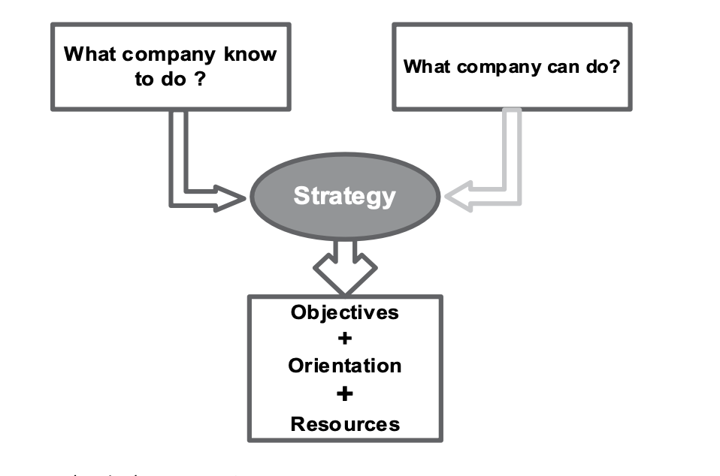
EIS and Company Strategy
Defining company’s strategy means choosing the areas of activity in which the company intends to be present and allocate resources to maintain and develop.
Defining a company's strategy involves selecting the areas of activity where the company aims to be active and allocating resources to sustain and develop these areas. Enterprise Information Systems (EIS) support this process by aligning company capabilities with strategic objectives, orientation, and resources.

Slide 33
Two Levels of Company Strategy
Group Strategy
Determines the company business areas
Competitive Strategy
Strategy to be implemented in each of these business areas.
Company strategy operates on two levels: Group Strategy, which determines the overall business areas the company will focus on, and Competitive Strategy, which outlines the specific strategies to be implemented within each of these business areas to achieve competitive advantage.

Slide 34
Complexity Factors of EIS
Heterogeneity
The multiplicity and diversity of the models used: various models from different points of view, different levels of abstraction, types of abstraction, usage categories and domains
Autonomy
Autonomy is driven by the fact that an information system is never isolated; it is embedded in its environment and consequently info another system with which it interacts through interfaces, technical devices, temporal and factual events.
Evolution and Dynamism
The information system is scalable in response to changes in its environment (strategi, business, or technological changes that the company is undergoing).
Enterprise Information Systems (EIS) face complexity due to heterogeneity, autonomy, and evolution. Heterogeneity involves diverse models and abstractions; autonomy refers to the system's interactions within its environment; and evolution signifies the system's scalability and adaptability to strategic, business, and technological changes.

Slide 35
IT Governance Framework
Goal: Explain and reframe key concepts of Information System and its relationship with IT Governance.

Slide 36
IT Governance involves the frameworks and processes that ensure IT assets are aligned with business goals, defining decision-making rights and responsibilities. At its core, IT governance is an organizational model for identifying and solving problems to leverage IT effectively within a company.
IT Governance
There many definitions of IT Governance. Check the textbook page 23-24 for more information.
At the conceptual core of IT, governance processes is an organisational model of decision making, defined as identifying and solving problems.
(Rezaee and Reinstein, 1998)
The clarification of decision-making rights and responsibilities as companies seek to leverage IT assets to business goals.
(Maleh et.al, 2019)

Slide 37
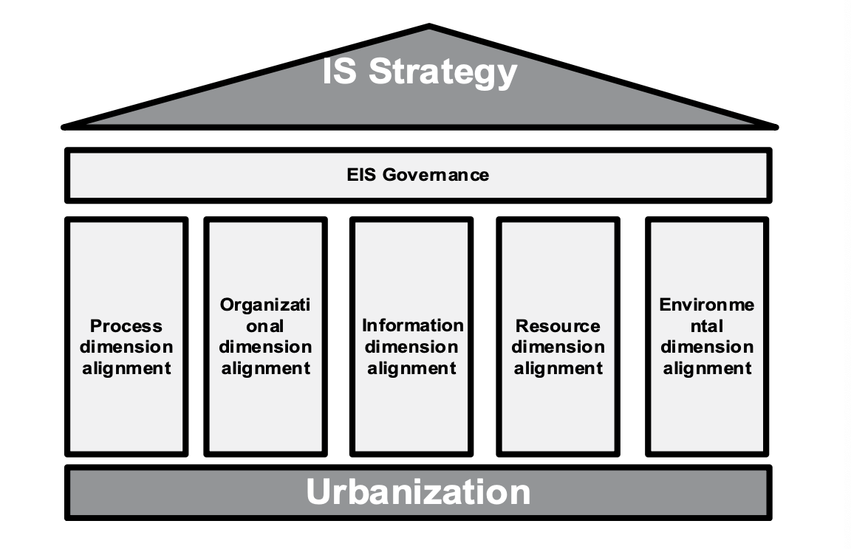
Urbanisation of Information System
Urbanisation is the driving force behind a company evolution, whose key to success is the effective use of information.
Urbanisation of the Information System is a key driving force behind company evolution, focusing on the effective use of information. This involves aligning various dimensions such as processes, organization, information, resources, and the environment with the overall IS strategy to ensure cohesive and efficient governance.

Slide 38
Urbanisation Challenges
Cost-saving
Providing More Value
Flexibility
Cost-Effective and Efficient Production
Interoperability
Opening
Ensure Quality of Service
Urbanisation of Information Systems involves addressing several challenges, including cost-saving, providing more value, ensuring flexibility, achieving cost-effective and efficient production, enabling interoperability, facilitating opening, and ensuring the quality of service. These challenges must be managed to align the information system strategy with overall business goals effectively.

Slide 39
Three Phases of Urbanisation
Determine the business strategy required to satisfy the need;
Definition of functional requirements and specific mapping;
Identification of technological orientations.
The three phases of urbanisation involve determining the business strategy needed to meet organizational requirements, defining functional requirements and specific mappings, and identifying technological orientations to support the overall information system strategy.

Slide 40
Rules and Good Practice of Urbanisation
Zone: an area forms a homogeneous family of neighborhoods with same construction rule and linkage.
Neighborhood: a fraction if a processed information system.
Block: a block is a set of homogeneous data and processing
Effective urbanisation of information systems involves organizing areas into zones, neighborhoods, and blocks. A zone is a homogeneous family of neighborhoods with common construction rules, a neighborhood represents a fraction of the processed information system, and a block is a set of homogeneous data and processing activities. These practices help streamline the management and alignment of information resources with business strategies.

Slide 41
Flexibility
Flexibility is the ability to react to environmental change in information systems, organisational theory, strategic management or operational management (Lee and Xia, 2005).
IT Flexibility is often characterised by organisational capacity to support various information technologies and services based on four dimensions:
Compatibility
Connectivity
Modularity
IT Staff Flexibility
Flexibility refers to the ability of an organization to adapt to environmental changes in information systems, organizational theory, strategic management, or operational management. IT flexibility is characterized by the organization's capacity to support various information technologies and services based on compatibility, connectivity, modularity, and IT staff flexibility.

Slide 42
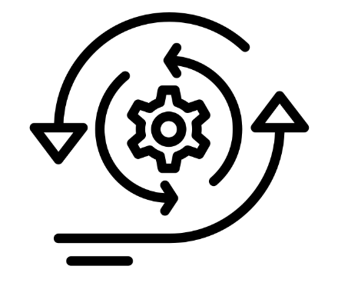
Agilility
The concept of agility is often associated with terms such as flexibility, dynamic, and organic.
Four established areas of agility of the IS are: 1. IT Infrastructure
2. IS Development
4. IS Organisation
5. IS Personnel
Agility in information systems is associated with flexibility, dynamism, and being organic. It encompasses four key areas: IT infrastructure, IS development, IS organization, and IS personnel, which collectively enhance the system's ability to rapidly adapt to changes and efficiently support organizational needs.

Slide 43

IS Development (ISD)
Two central components of ISD flexibility:
Response Effectiveness
Effectiveness of the response
Continuous readiness of an ISD Method: Create a change quickly or inherently, to adopt it proactively or reactively, and to learning from the change while contributing to the perceived value of the client.
IS Development (ISD) flexibility is defined by two main components: response effectiveness and the effectiveness of the response. Continuous readiness of an ISD method involves the ability to create and adopt changes quickly, either proactively or reactively, while contributing to the perceived value for the client.

Slide 44
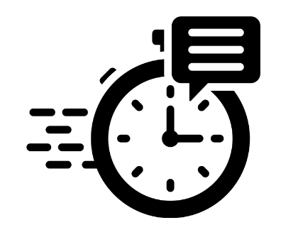
Design of IT Infrastructure
Infrastructure flexibility determines ISD’s ability to respond quickly and cost effectively to system demands which evolve as business practices or strategies challenges.
Ideal Situation:
Flexible infrastructure would be an infrastructure designed to evolve itself with emerging technologies and support the ongoing restructuring of related activities and processes (Duncan, 1995).
Infrastructure flexibility determines ISD's ability to quickly and cost-effectively respond to evolving system demands driven by changes in business practices or strategies. Ideally, a flexible infrastructure should be designed to adapt to emerging technologies and support the continuous restructuring of related activities and processes.

Slide 45

Dimensions of IT Infrastructure
IT Connectivity
IT Application Functionality
IT Compatibility
Data Transparency
Technology Management
Business Knowledge
Management Knowledge
Technical Knowledge
The dimensions of IT infrastructure encompass IT connectivity, IT application functionality, IT compatibility, data transparency, technology management, business knowledge, management knowledge, and technical knowledge. These dimensions collectively define the capabilities and effectiveness of an IT infrastructure in supporting organizational goals.

Slide 46
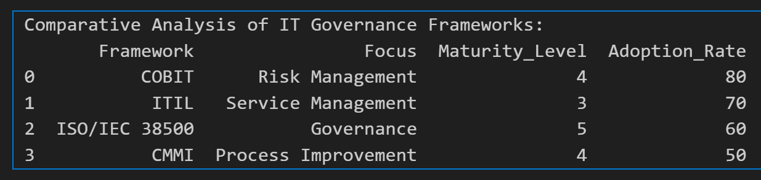
Comparative Analysis of IT Governance Frameworks
COBIT: Emphasizes risk management, providing comprehensive guidelines to identify, assess, and mitigate risks in IT operations.

Slide 47
Comparative Analysis of IT Governance Frameworks
ITIL: Centers on service management, focusing on improving IT service delivery and support processes to enhance overall service quality.

Slide 48
Comparative Analysis of IT Governance Frameworks
ISO/IEC 38500: Concentrates on governance, offering principles and practices to guide effective IT governance at a strategic level.

Slide 49
Comparative Analysis of IT Governance Frameworks
CMMI: Targets process improvement, aiming to refine and optimize processes for better performance and efficiency.

Slide 50
Comparative Analysis of IT Governance Frameworks
The maturity level indicates how well-established and developed a framework is within organizations.
Adoption rates reflect the popularity and widespread use of these frameworks in various industries.
For instance, COBIT has a high adoption rate of 80%, suggesting it is widely trusted for risk management, while CMMI has a lower adoption rate of 50%, indicating it might be more specialized or less universally applied.

Slide 51
Example
A large enterprise in Sydney might choose COBIT to enhance its risk management practices, ensuring robust controls and compliance with regulatory requirements, thus protecting the organization from potential IT-related risks.

Slide 52

Literature
Belaissaoui, M., Sahid, A., Maleh, Y., Alazab, M. (2021). IT Governance and Information Security: Guides, Standards and Frameworks. (n.p.): CRC Press.

Slide 53

Reading Materials
Prescribed Reading Belaissaoui, M., Sahid, A., Maleh, Y., Alazab, M. (2021). IT Governance and Information Security: Guides, Standards and Frameworks. (n.p.): CRC Press.

Slide 54
Reading Materials
Recommended Reading
Batyashe, N. T. R. (2021). Deployment of Information Technology Governance Using Architectural Framework. In Empowering Businesses With Collaborative Enterprise Architecture Frameworks (pp. 199-215). IGI Global.
Nyonawan, M., & Utama, D. N. (2018, September). Evaluation of Information Technology Governance in STMIK Mikroskil Using COBIT 5 Framework. In 2018 International Conference on Information Management and Technology (ICIMTech) (pp. 137-142). IEEE.
Rizal, R. A., Sarno, R., & Sungkono, K. R. (2020, September). COBIT 5 for analysing information technology governance maturity level on masterplan E-Government. In 2020 International Seminar on Application for Technology of Information and Communication
(iSemantic) (pp. 517-522). IEEE. Setyadi, R., & binti Abd Rahman, A. (2018, October). Assessing the Information Technology Governance Trust Using Readiness and Usability Models: A Model Development Study.
In 2018 International Conference on ICT for Rural Development (IC-ICTRuDev) (pp. 131-136). IEEE.
Wilkin, C. L., & Chenhall, R. H. (2020). Information technology governance: Reflections on the past and future directions. Journal of Information Systems, 34(2), 257-292.

Slide 55
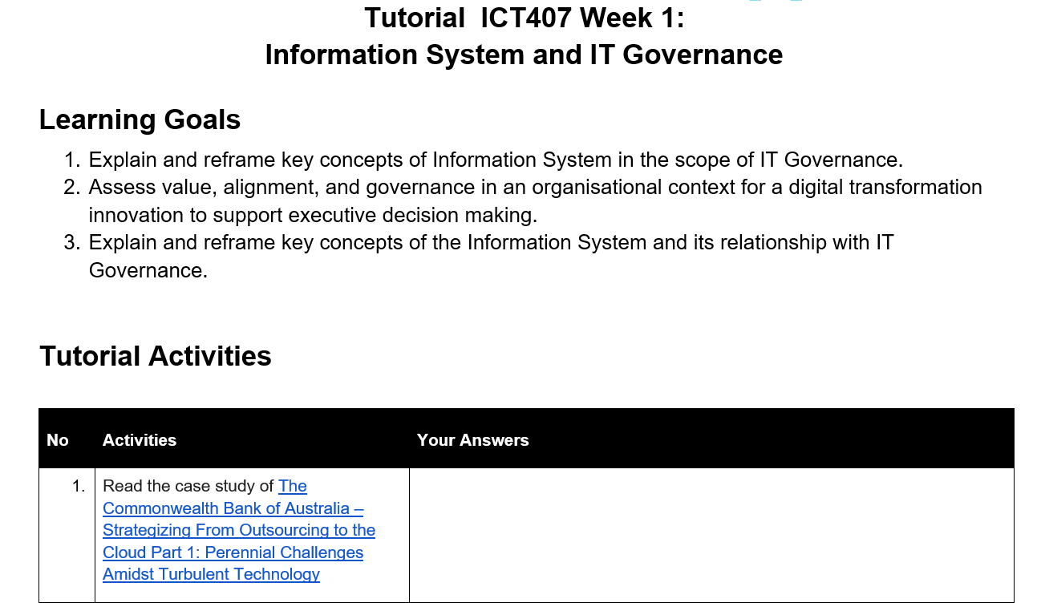
Tutorial Week 1

Slide 56
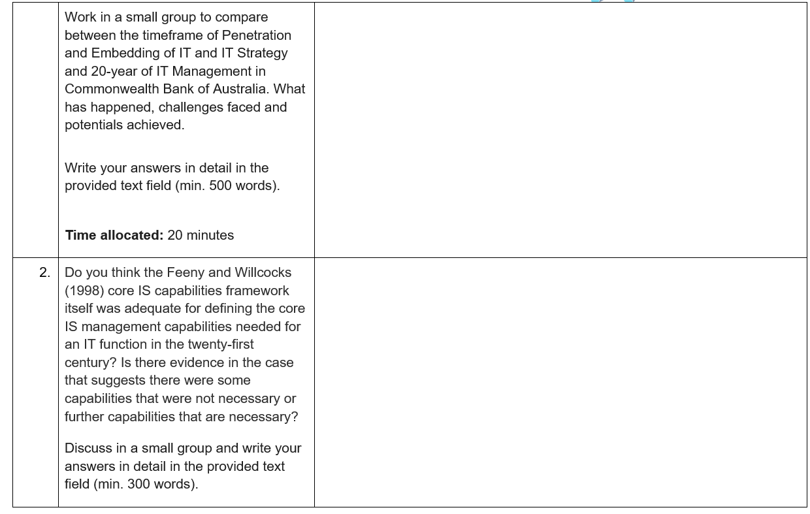
Tutorial Week 1

Slide 57
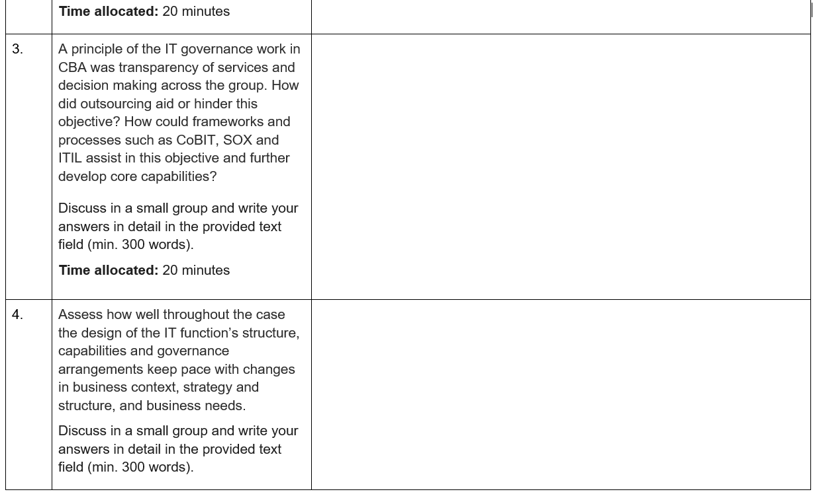
Tutorial Week 1

Slide 58
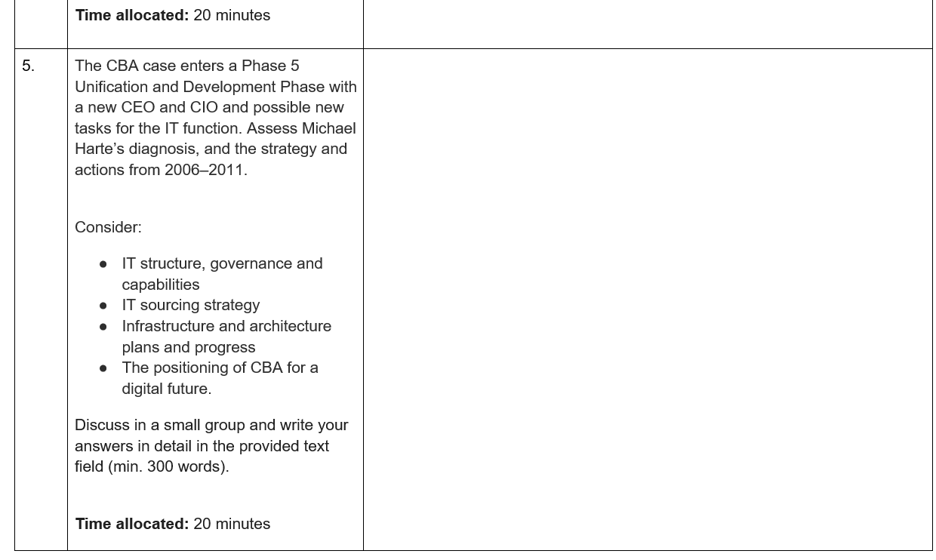
Tutorial Week 1

Slide 59
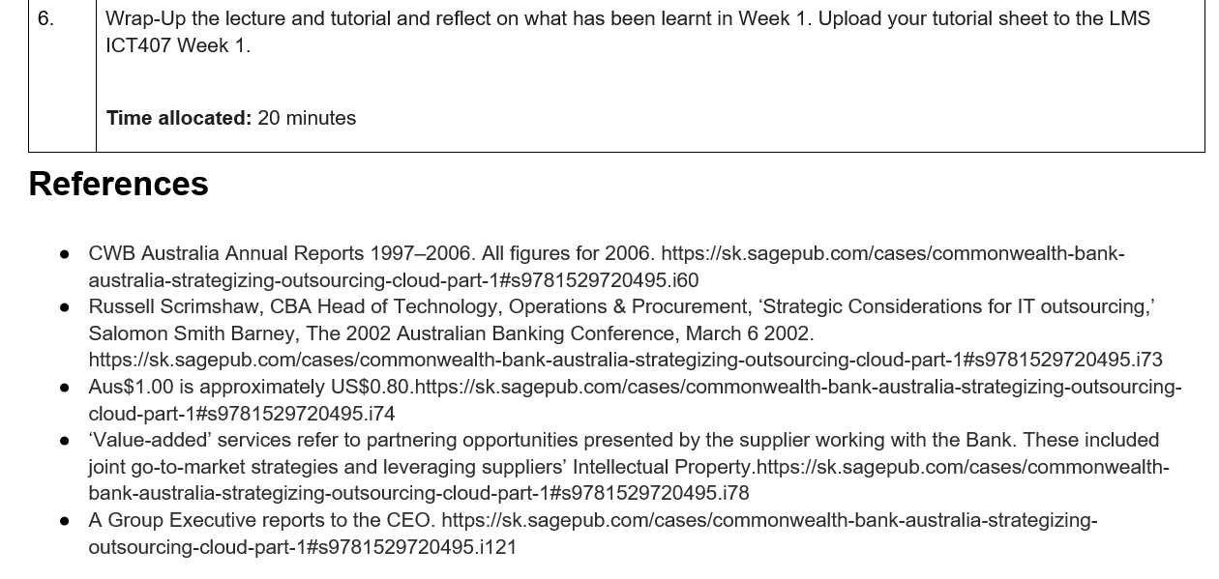
Tutorial Week 1

